Slide 1
Digtal Image
-what is digital Image

Slide 2
What is digital Images
A digital image can be interpreted as a rectangular array of numbers.
In many cases it’s easier to understand a gray-scale image, an image that is made up of different shades of gray.
Notes:
(디지털 이미지는 숫자의 직사각형 배열로 해석될 수 있다.)
(많은 경우 회색 음역 즉, 회색 배경 이미지를 이해하는 것이 더 쉽다. )

Slide 3
<pixel>
255 | 255 | 255 | 255 | 0
255 | 255 | 255 | 255 | 0
255 | 255 | 0 | 0 | 0
255 | 0 | 0 | 0 | 0
intensity value
digital images have intensity values between zero and 255 (0 ~255, total: 256).
Contrast: the difference between these values
The lower the intensity value, you can start seeing a difference in regions of low contrast.

Slide 4
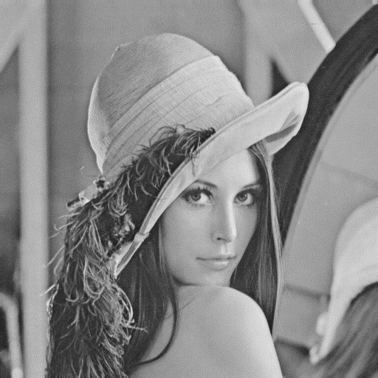
Move down
0
Each pixel or intensity Value has its own index.
Each pixel value comes from a grid of sensors.
0
1
2
3
.
.
.
500
500
0
500
0 | 1 | 2 | 3 | . | . | . | 500
Move right
Notes:
회색의 어두운 색조와 검은색은 0으로 낮은값을 가지며, 밝은 색조는 255로 높은 값을 가진다.
Contrast(대비): 이 값 사이의 차이
숫자 배열 높이는 행의 수 너비는 열의 수
각 픽셀 또는 명암 값에는 자체 인덱스(index)를 지님.
행의 경우 이미지의 맨 위(0 ~)에서 아래로 (~)
열의 경우 이미지의 왼쪽에서 (0 ~) 오른쪽으로 이동(~ )
각 픽셀은 sensor grid에서 나온다.

Slide 5
RGB Image
These color values are represented as different channels intensity values. Color image is like a cube.
We also have an index for each channel
In this case
Zero for red
One for blue
Two for green
2
1
0
index

Slide 6
Video sequence
Video sequence is a sequence of images.
이미지는 컴퓨터에 있는 파일입니다. JPEG(Joint Photographic Expert Group)와 PNG(Portable Network Graphics)의 두 가지 대중적인 이미지 형식은 파일 크기를 줄이고 다른 기능을 제공합니다.
어떤 파이썬 라이브러리를 사용하든 이미지를 로드해야됨. 그리고 코드에 동일한 디렉토리에 있는 경우 파일의 이름이 필요하고 다른 경로에 있는 경우 필요한 건 파일의 경로
The pill, PIL library: 파이썬에서 이미지로 작업하는데 널리 사용되는 라이브러리

Slide 7
Image processing with Pillow
Code

Slide 8
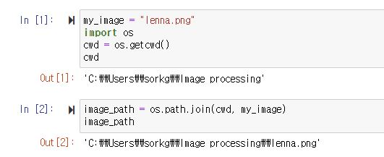
Image Files and Paths
Define my_image as the filename of file in this directory
Python's os module. The os module provides functions to interact with the file system, e.g. creating or removing a directory (folder), listing its contents, changing and identifying the current working directory.
The "path" to an image can be found using the following line of code. (find a path to an image)

Slide 9
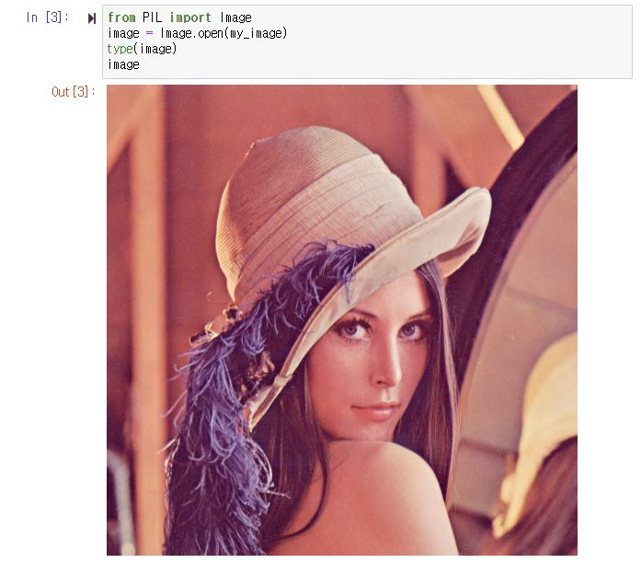
Load image in python
Pillow (PIL) library is a popular library for loading images in Python. In addition, many other libraries such as "Keras" and "PyTorch" use this library to work with images. The Image module provides functions to load images from and saving images to the file system.
<load image to use PIL library>

Slide 10
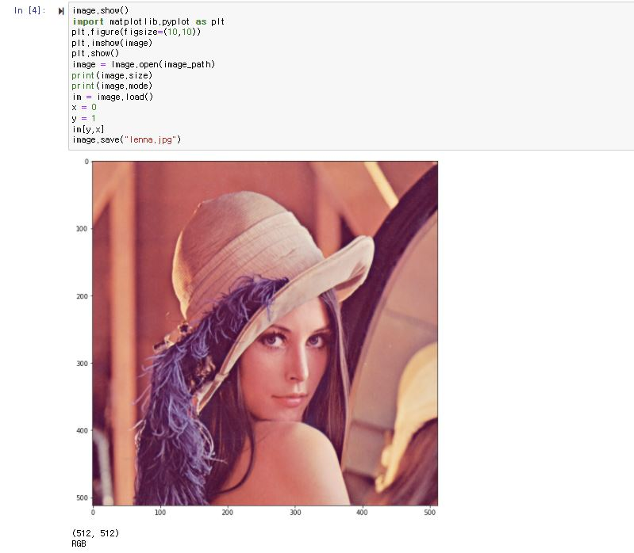
Plotting an Image (구성)
image.show() #display the image
import matplotlib.pyplot as plt #imshow method from the matplotlib library to display .the image
plt.figure(figsize=(10,10))
plt.imshow(image)
plt.show()
image = Image.open(image_path) # load the image using its full path
print(image.size) # returns a tuple, first element is the number of pixel(width), second, (heigh)
print(image.mode) # string specifying the pixel format used. This case “RGB”
im = image.load() #PIL dbject read the file content, decodes it, and expand the image into memory
x = 0 #column
y = 1 # row
im[y,x]
image.save("lenna.jpg") #save the image in jpg

Slide 11
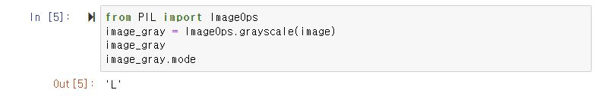
Grayscale images
ImageOps module most operators only work with grayscale and/or RGB image
‘L’ means luminance(밝기)

Slide 12
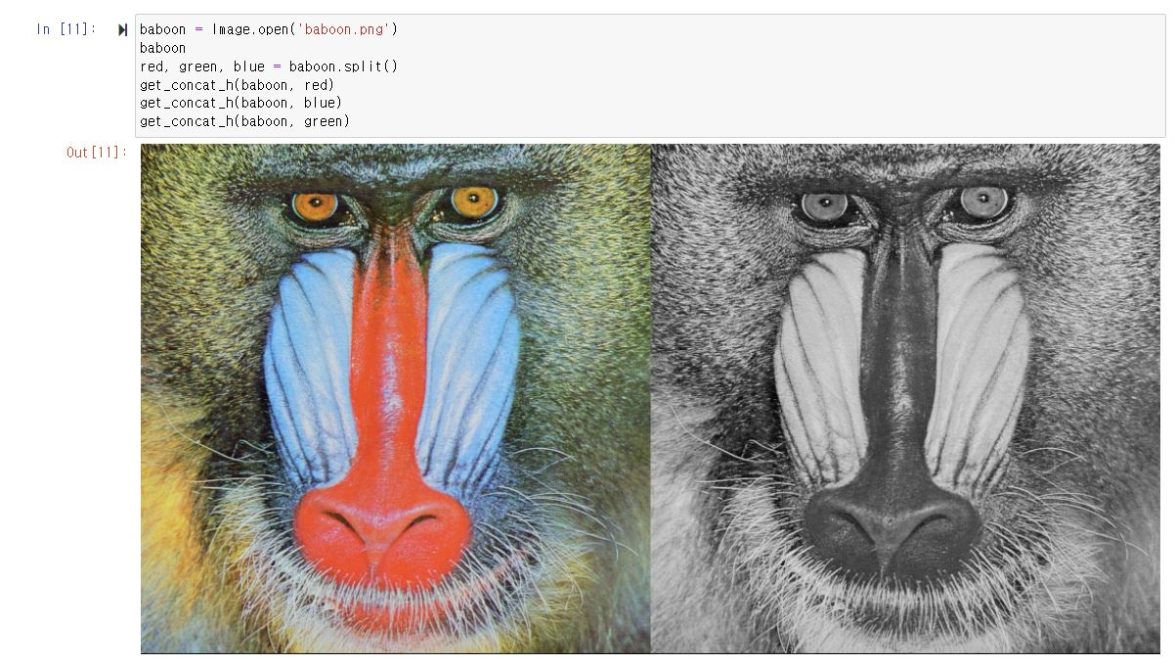
Color Channels
Plotting the color image next to the color channel as a grayscale, we see that regions with red have higher intensity values.

Slide 13
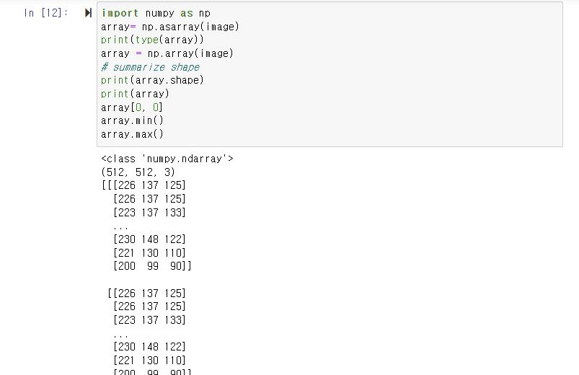
PIL images into NumPy Array
NumPy is a library for Python, allowing you to work with multi-dimensional arrays and matrices.
We can view the intensity values by printing out the array they range from 0 ~ 255
And can find the maximum and minimum.

Slide 14
Image processing with OpenCV
Opencv is a library used for computer vision.

Slide 15
Opencv
Imread() – load an image from the specified file, the input is the path of the image to be read
Imshow()- function, to open the image in a new window in Jupyter.
cvtColor – can change the color space with conversion code and the function – can change gray

